Slide 1
Camera Traffic Counts: Final Project
By: John Trelford, Lucas Chiang, Travis Welsh, Brian Pham, and Ritesh Penumatsa
(Group 11)
Notes:
John

Slide 2

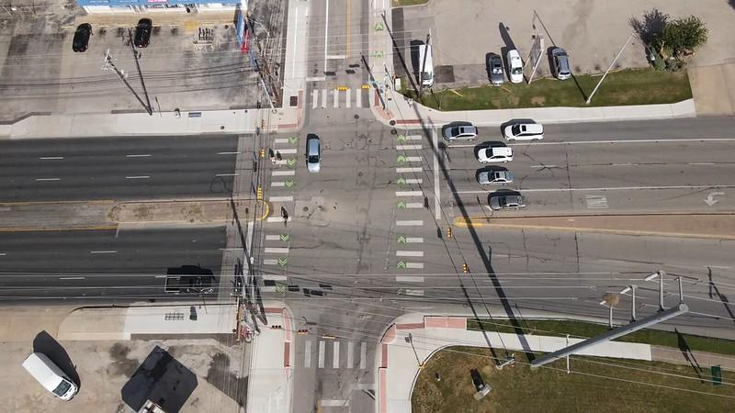
Dataset Overview
Camera Traffic Counts
15-minute interval traffic by intersection in Austin
Collected by GRIDSMART optical traffic detectors
Visual Crossing Weather Data
Includes Austin climate conditions by day
Notes:
John

Slide 3
Subsetted Data
How?
Why?
Filter to only rows where year = 2019
14,717,624 rows in dataset where year = 2019
Shape (rows, columns) = (14717624, 19)
Prevents interference from the COVID-19 pandemic period
The full Camera Traffic Counts dataset was 82.1 million rows
Overwhelms RAM
Computationally Intensive
Notes:
John

Slide 4
Explanation Task:
What factors drive congestion at intersections?
Notes:
John

Slide 5
Overall Goal
We aim to identify the key features driving traffic volume
to help people know under what conditions
they should expect more or less traffic.
This will allow people to more efficiently plan their
excursions on the road so that they waste less time.
Goal
Our goal is causal understanding to inform individuals’ driving decisions by identifying factors that can reduce wasted time on the road.
Notes:
John

Slide 6
Data & Choice of Features
Target Variable: Volume
Choice of Features:
Day of the Week - Travel patterns vary throughout the week
One-hot encoded to properly weight the categorical variable
Holiday - Travel patterns deviate around major holidays
Precipitation - Severe weather affects travel patterns
Heavy Vehicle Present - Larger vehicles affect turns
Time - Travel patterns vary throughout the day (ex: morning and afternoon rushes)
Lagged Volumes - Captures short-term dynamics
Visibility - Low visibility makes driving less safe; some drivers would be more cautious
Temperature - May be more/less likely to drive in drastic temperatures
Notes:
John

Slide 7
Model Setup
Splitting the dataset
Training set: January-September
Validation set: October-November
k-fold cross-validation is inappropriate because it breaks the time order
Testing set: December
Avoids temporal leakage so that only past data predicts future observations
Ensures an unbiased estimate of generalization because it simulates the real world scenario of predicting traffic volume without knowledge of the future.
Notes:
John

Slide 8
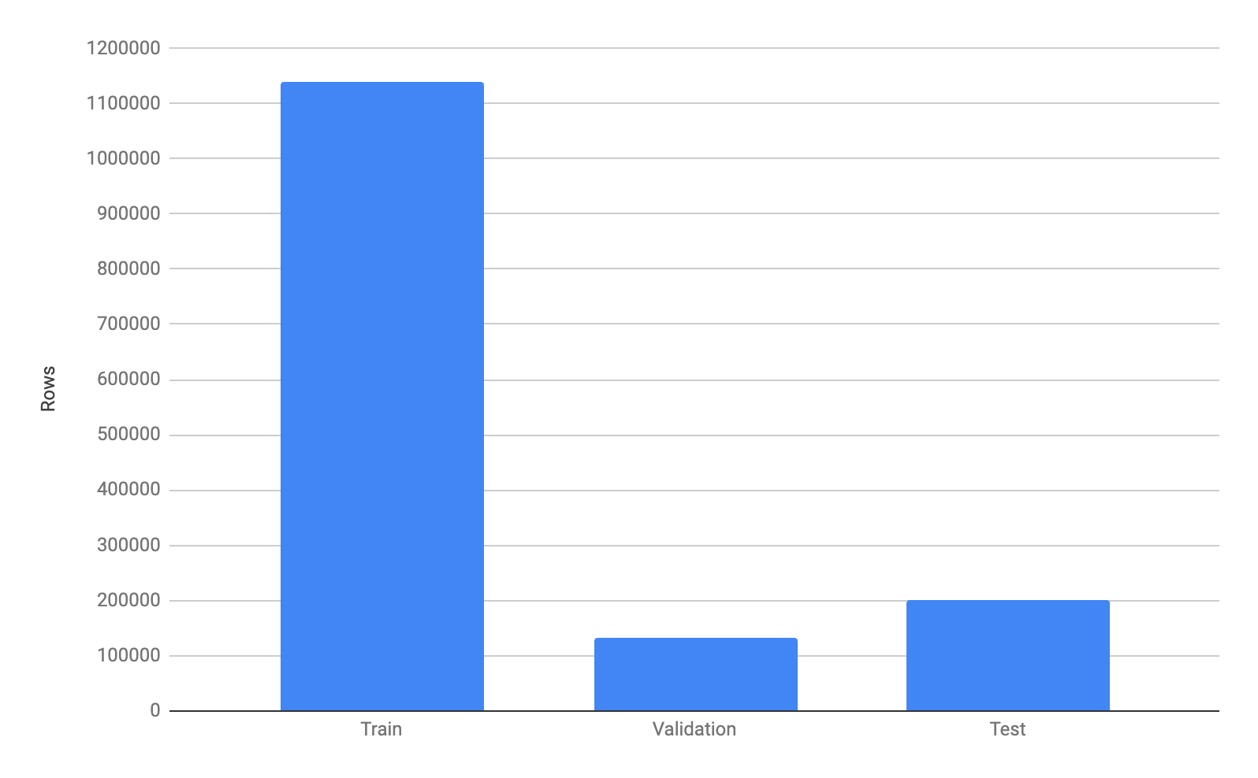
Notes:
John

Slide 9
Justification of Feature Set
01 | Nature of Outcome
 | Volume is a real-valued outcome
02 | Data Availability
 | Data is available for every observation
03 | Data Integrity
 | There is no data leakage
04 | Causal Structure
 | All predictors are causally before volume
05 | Predictive Signal
 | All features are expected to have a meaningful relationship with volume
Notes:
John

Slide 10
Limitations
Avoidance of Temporal Leakage: By strictly partitioning the data chronologically, we ensure that the model has no knowledge of the future (temporal leakage), guaranteeing that evaluation metrics are less biased estimates of our model’s performance.
Real-World Applicability: If the model performs well on the December test set, it provides confidence that the important features in the model reflect what factors are associated with changes in traffic volume.
Bias and Noise:
01
Seasonality
03
Holiday Impact
Seasonality dictates travel and commuter volume
The holiday period potentially impacts traffic patterns
02
Demographic change
Anomalies
04
Long-term population increases could dramatically impact traffic volume
Natural disasters, road closures, and pandemics can disrupt usual trends
If we used traffic data for more years, we could account for seasonality, demographic change, and holiday impact. Anomalies would likely require real-time adjustment to deal with. For us, some error is inevitable due to the novelty of the December test environment and only using 2019 data for training.
Notes:
John

Slide 11
Model Choice
Model Class 1: Linear Regression
Appropriate for temporal data with smoothly changing trends
Easy to interpret the coefficients
Low variance
Low computational cost
Avoids overfitting (few features yet millions of samples)
Can optimize coefficients by L2 regularization
Model Class 2: Random Forest
Able to model complex relationships between variables
More resistant to outliers in the data
Adapts to non-linear relationships
Notes:
Brian

Slide 12
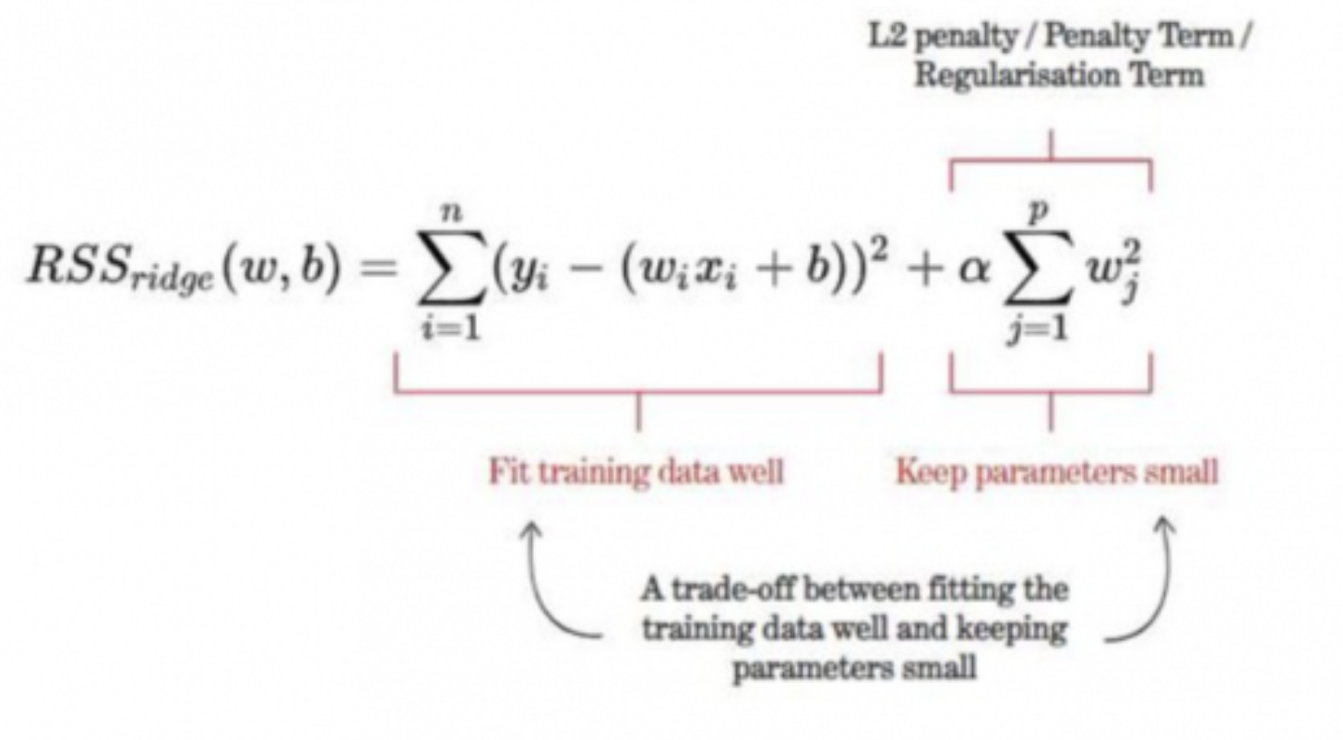
Model Choice cont.
Linear Regression Limitation
Coefficients become unstable and unreliable
Problem caused by multicollinearity (highly correlated features)
Our one-hot encoding creates this issue
Ridge Regression Solution
It is Linear Regression plus an L2 regularization term
L2 penalty shrinks coefficient magnitudes toward zero
Helps in preventing overfitting
This shrinking stabilizes the coefficient estimates
Result: Reliable coefficients for interpretation

Slide 13
Hyperparameter Tuning
Ridge Regression
Random Forest
ɑ, the strength parameter of the ridge regression penalty was tuned (.001 was selected from values: 0.001, 0.01, 0.1, .2, .3, .5)
Search method: Minimizing RMSE with a list of parameters on the validation set
Penalizes large errors more heavily
Want to protect against large mispredictions
N_estimators, max_depth, min_samples_leaf, and min_samples_split were tuned
The search method was done on a predefined set of values and yielded the following results:
N_estimators = 50
Max_depth = 9
Min_samples_leaf = 2
Min_samples_split = 5
Note: We specifically didn’t use GridSearchCV or RandomizedSearchCV to avoid temporal leakage hence why most of the parameters were manually tuned on the validation set (October - November).

Slide 14
Evaluation Metrics
Evaluation metrics
RMSE
Ensures there are not large mispredictions
In the same units as the target variable, so easy to interpret
How much do the model’s predicted values deviate from the true values on average?
R²
Indicates how well the model explains the overall trends

Slide 15
Ridge Regression Model
Evaluation and Results
Notes:
Lucas

Slide 16
Statistically Significant Features
Feature | OLS Coefficient | P-Value
Precipitation | -2.499510e+08 | 9.752530e-01
Time (of day) | 2.015019e-01 | 0.000000e+00
lag_1 | 1.177328e-01 | 0.000000e+00
lag_2 | 2.859718e-01 | 0.000000e+00
lag_4 | 1.353272e-01 | 0.000000e+00
Visibility | 3.929092e-02 | 1.129897e-02
Temperature | 1.240402e-02 | 2.797525e-21
Heavy Vehicle | -1.800484e+01 | 0.000000e+00
We first fit a normal linear regression model using OLS and found the regression summary to see which features in normal linear regression are statistically significant.
The features on the left were statistically significant in the model, meaning that there is evidence of a relationship between these features and volume
The dummy variables for days of the week were not statistically significant, likely because the Time (of day) already accounted for that variation in this run of the model (multicollinearity)
Notes:
Lucas

Slide 17
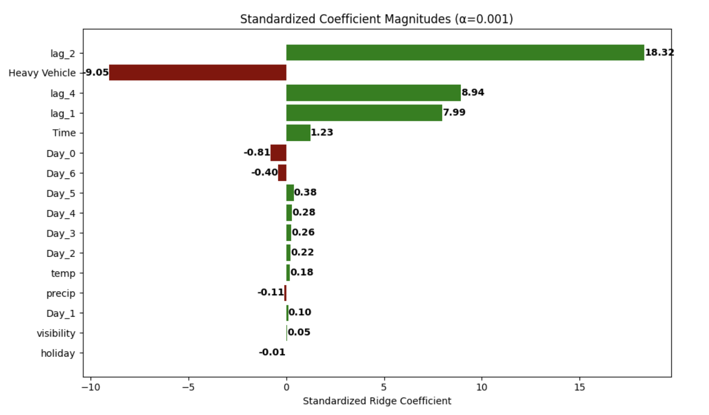
Ridge Regression Results
Notes:
Lucas

Slide 18
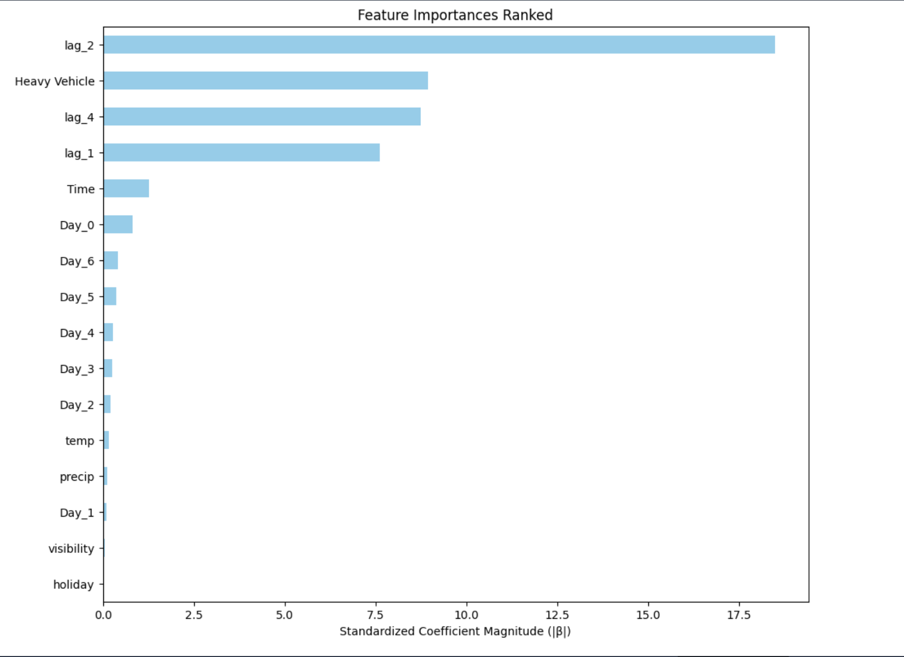
Ridge Regression Feature Importances
The five most important features:
Lag_2
Heavy Vehicle Presence
Lag_4
Lag_1
Time
Notes:
Lucas

Slide 19
Evaluation of Ridge Regression
R²: 0.2283659
RMSE: 50.51293
The R-Squared for ridge regression is .23, which means that the model explains around 23% of the variation in traffic volume. The Root Mean Squared Error is 50.513, meaning the model’s prediction error on average is about 50 units of traffic volume.
Notes:
Lucas

Slide 20
Random Forest Regression
Evaluation and Results
Notes:
Ritesh

Slide 21
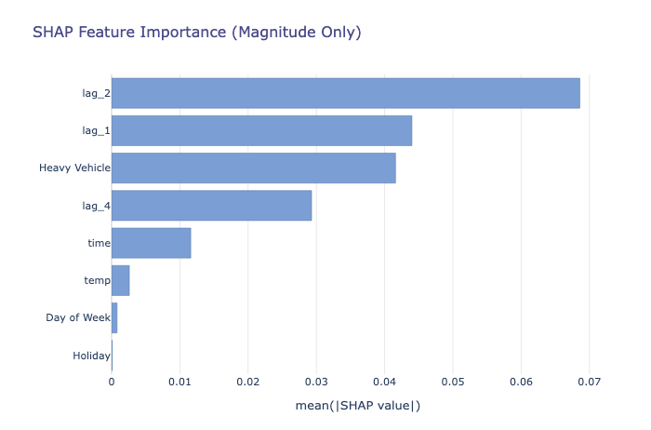
Random Forest Feature Importance
This model highlights the impact of model features on model’s predictions overall.
The five most important features:
Lagged Volumes
Vehicle Type
Time
Weather
Day of Week
lag_2 is the most important
lag_1 and Heavy Vehicle also important
Holiday and Day of Week barely matter
It averages the absolute SHAP values across all samples.
Larger bar = feature has a bigger impact on predictions.
Notes:
Ritesh

Slide 22
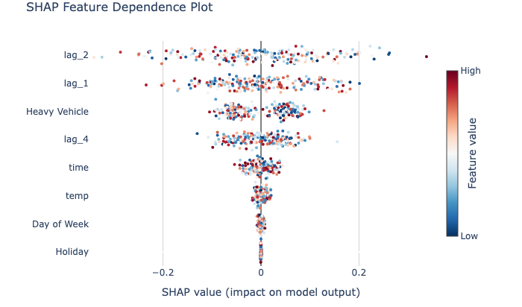
Random Forest Feature Importance
01
Direction of Impact
Whether a feature pushes predictions up or down from average model prediction. Positive SHAP values push it up and Negative SHAP values push predictions down.
Feature interactions
02
The spread of red/blue points shows how the model reacts to different values of that feature.
Features with wide spreads (lags, heavy vehicles) have a big influence on predictions.
Features with narrow spreads (temp, holidays) barely move the prediction at all.
This scatter plot visualizes the impact of a single feature value on a model's prediction.
Notes:
Ritesh

Slide 23
Evaluation of Random Forest Regression
R²: 0.3263
RMSE: 47.1627
The R-Squared for random forest regression is .33, which means that the model explains around 33% of the variation in traffic volume. The Root Mean Squared Error is 47.163, meaning the model’s typical prediction error is on average about 47 units of traffic volume.
Notes:
Ritesh

Slide 24
Model Comparison
Notes:
Ritesh

Slide 25
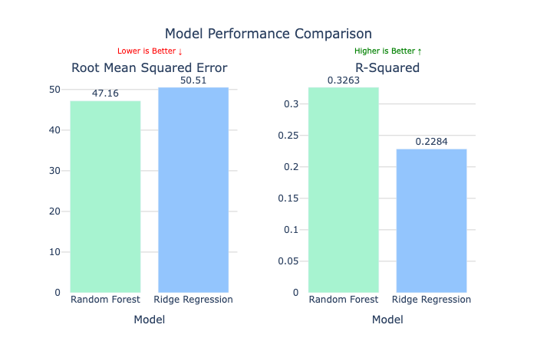
Notes:
Ritesh

Slide 26
Energy Considerations
Model | Total Training Fits | Avg. Training Time per Fit (s) | Energy Consumed (kWh) | CO₂ Emitted (kg CO₂ eq)
Ridge Regression | 1 | 0.5262 | 0.000007 | 0.000003
Random Forest | 1 | 57.1712 | 0.000794 | 0.000318
Notes:
Ritesh

Slide 27
Explanation and Interpretation
Our primary objectives are maximizing precision and minimizing large errors. Because our model does not need to be ran very frequently, we are not too concerned with the speed and energy trade-offs. Therefore, Random Forest (RF) is the superior predictive model for our problem.
RF Performance: Random Forest achieved a significantly greater R² and lower Root Mean Squared Error (RMSE) compared to Ridge Regression. The focus on minimizing RMSE aligns directly with our goal to protect against large mispredictions of traffic volume, which is critical for understanding the features most related to volume.
Trade-off Justification: While Ridge Regression was dramatically more energy- and time-efficient, these are not too important for practical applications of our model, which will not be ran frequently.
The Ridge Role: Although not the optimal model, the Ridge model was still crucial for its ability to produce stable, interpretable coefficients for analysis, which was its dedicated role in our project.

Slide 28
Interpretation
The models suggest that the majority of traffic congestion is driven by how busy the traffic intersection has been in the past, specifically the past 15-30 minutes (denoted by lag_1 and lag_2 and lag_4 to an extent). This tells us that traffic queues tend to “snowball” or stay busy when busy.
People should expect when traffic is busy, it will stay busy, so they could wait for less congested times to run their errands.
Another factor is the presence of heavy vehicles, which is correlated with less congestion.
People could choose to take alternate paths that heavy vehicles are likely to take.
Time of day affects congestion. For example, later times are correlated with higher congestion.
People can plan their outings to be earlier in the day.
Ridge regression indicates that volume is lower on weekends than on other days of the week

Slide 29
Thank You!
Any questions?

